Slide 1
History Data Generation and Category Dashboard Creation
03/07/2024

Slide 2
History Data Generation
Objective:-
To generate a two-year sales history when the customer provides one year of sales history for the proof of concept (POC).
To generate history in the same format as the DFAI daily sales files.
The test history should follow the same sales pattern provided by the customer.
To generate history DC wise or Store wise or Both

Slide 3
Methodology:-
We used one year sales data of DC 980 of SPN for our test history data generation.
We used Python to generate the test data.
First, we take the sales value present on the current date in the customer's dataset. Then, we look at the same date in the past and generate a random number within the threshold of -10 to 10 of the original value to maintain the sales pattern. For example, if today's sales are 500, then one year back, the sales will be a number between 490 and 510.
Promotion data is not included here because promotions can change from year to year.
If we need to generate data by store, then DC code will be zero. If by DC, then the store code will be zero. If we need both DC and store-wise data, then both DC and store codes will be present.

Slide 4
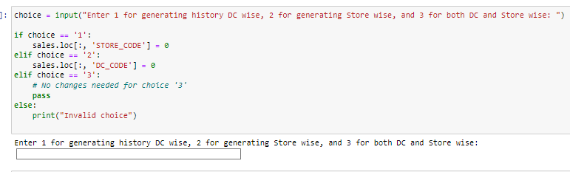
Result and Screenshots:-
Option to generate data Dc wise or Store wise or Both

Slide 5
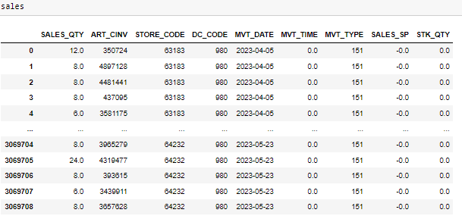
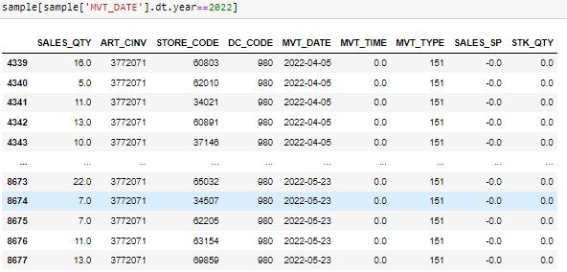
2023 sample data
2022 history generated

Slide 6
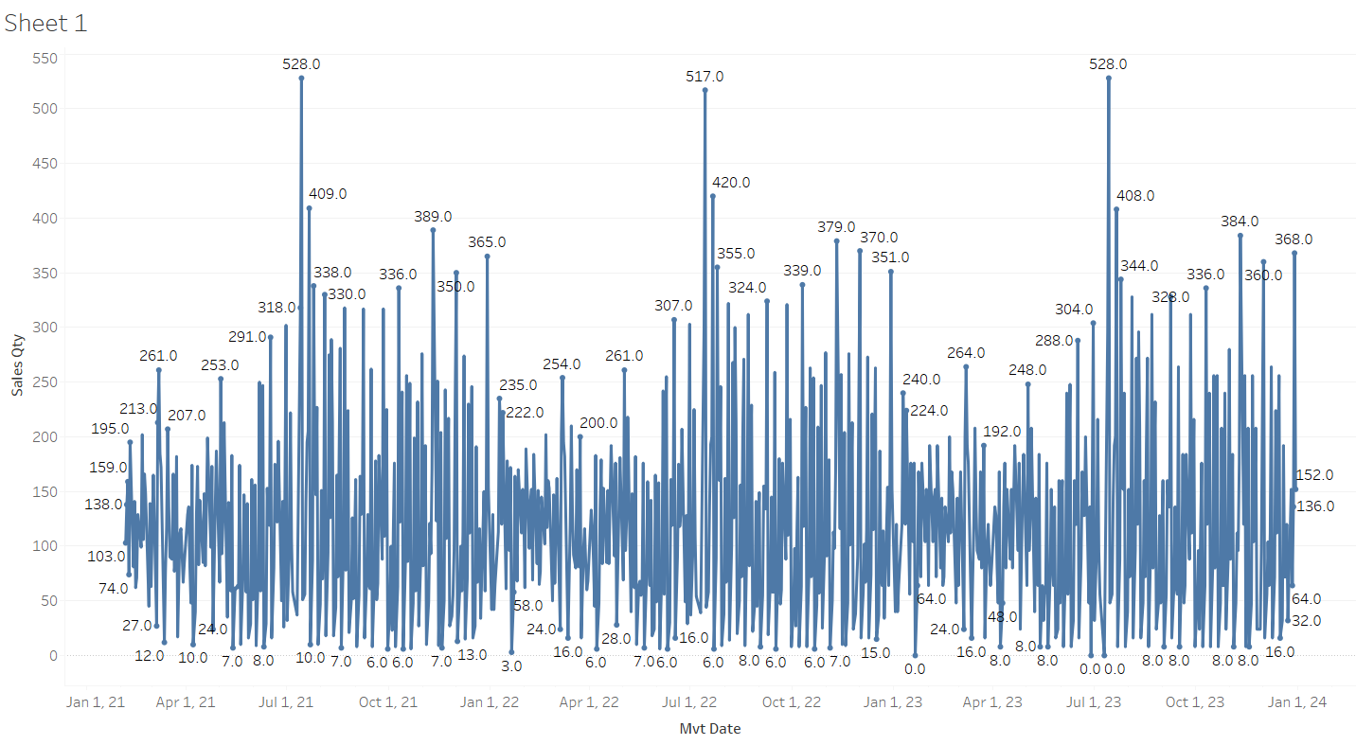
Sales pattern generated

Slide 7
Category Dashboard
Objective:-
To apply different formulas for different categories of SPN using the result files from the production run.
Create a dashboard containing the best and second-best formula for each category.

Slide 8
Formula Definition:-
WMAPE->A measure of forecasting accuracy that weighs errors by the absolute value of the actual data, providing a more realistic view of forecasting performance.
MAPE->A measure of forecasting accuracy that calculates the average absolute difference between forecasted and actual values as a percentage of actual values
SMAPE->A variation of MAPE that treats over- and under-forecasting equally, providing a more balanced view of forecasting performance.
RMSE->measure of forecasting accuracy that calculates the square root of the average squared differences between forecasted and actual values, providing a measure of the spread of errors.
MSLE-> A measure of forecasting accuracy that calculates the average squared difference between the logarithms of forecasted and actual values, providing a measure of relative errors.
MAE-> A measure of forecasting accuracy that calculates the average absolute difference between forecasted and actual values, providing a measure of the spread of errors.
RMSLE->A measure of forecasting accuracy that calculates the square root of the average squared logarithmic differences between forecasted and actual values, providing a measure of relative errors.

Slide 9
Formulas applied:-
WMAPE= SUM(ABS(Actual Sales - Forecast Value)) / SUM(Actual Sales)
MAPE=AVG(abs(Actual Sales-Forecast Value)/Actual Sales)
SMAPE=AVG(ABS(Forecast Value - Actual Sales) / ((ABS(Forecast Value) + ABS(Actual Sales)) / 2))
MAE=AVG(ABS(Actual Sales -Forecast Value))/100
RMSE=SQRT(AVG((LOG(Actual Sales + 1) - LOG(Forecast Value + 1))^2))
MSLE=AVG((LOG(Actual Sales + 1) - LOG(Forecast Value + 1))^2)
RMSLE=SQRT(SUM((LOG(1 + Actual Sales) - LOG(1 + Forecast Value))^2) / COUNT(Actual Sales))

Slide 10
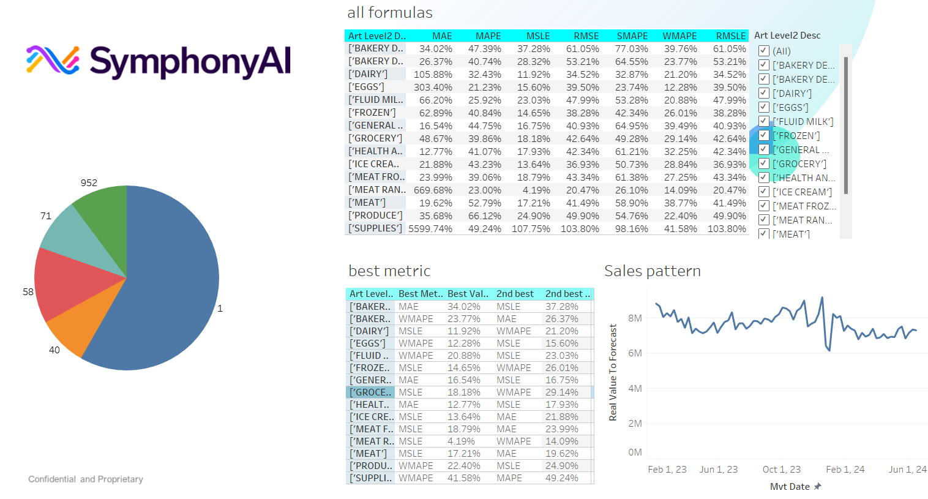
Dashboard:-

Slide 11
Conclusion:-
We have designed a script that can generate a history of data containing the same sales pattern when the customer provides one year of sales data to us, so we can use that data in DFAI for the proof of concept (POC). We have provided options to generate sales history by Store, by DC or both.
The dashboard contains different error formulas for different categories of SPN. Some of the formulas show as MSLE and MAE are performing better than WMAPE for different categories.

